Slide 1
WELCOME

Slide 2
PBL Project
SEM -II
Batch- B2 & B3
By ,
Aman Arif Mansuri-256
Soham Ashok Kulkarni-235
Mayur Sanjay Patil-262
Atharva Nikam-263
Subject Teacher- Gayatri Jadhav

Slide 3
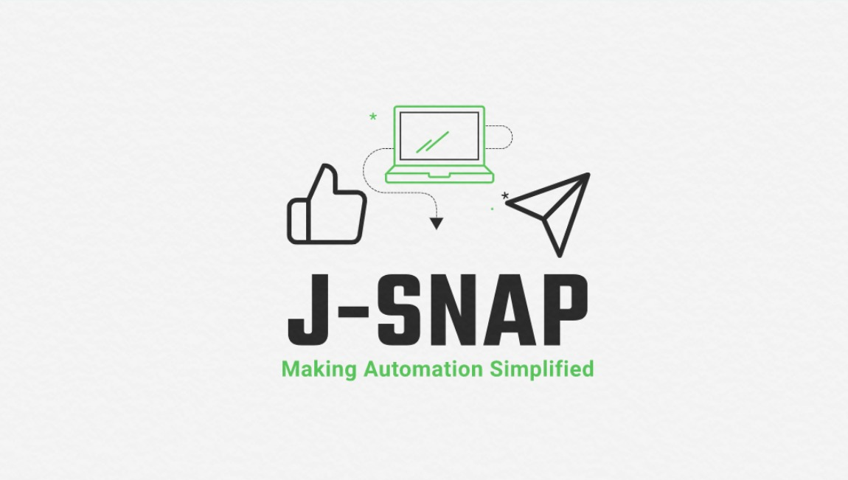

Slide 4

What is Automation?
The application of technology, programs, robotics or processes to achieve outcomes with minimal human input. This includes business process automation (BPA), IT automation, personal applications such as home automation and more.
Types of Automation
Basic automation
Basic automation takes simple, rudimentary tasks and automates them. Business process management (BPM) and robotic process automation (RPA) are types of basic automation.

Slide 5
2. Process automation
Process automation manages business processes for uniformity and transparency. It is typically handled by dedicated software and business apps. Using process automation can increase productivity and efficiency within your business. Process mining and workflow automation are types of process automation.
3. Integration automation
Integration automation is where machines can mimic human tasks and repeat the actions once humans define the machine rules. In recent years, people have defined digital workers as software robots that are trained to work with humans to perform specific tasks. They have a specific set of skills, and they can be “hired” to work on teams.
4. Artificial intelligence (AI) automation
The most complex level of automation is artificial intelligence (AI) automation. The addition of AI means that machines can “learn” and make decisions based on past situations they have encountered and analyzed.

Slide 6

What is Social Media Automation?
Social media automation is automating social media applications by using AI or any other means and using this automation to make our day to day life easier and time saving.

Slide 7
What is J-SNAP?
J-SNAP or JARVIS SOCIAL NETWORKING AUTOMATION PROGRAM is a program that runs on python-based code as a third-party bot to various social networking sites like Instagram, Facebook, Twiter etc.
It can do all the basic tasks that can be done by humans on social media platforms and in a very time-saving manner so that the lifestyle of users can be efficient.

Slide 8


Technology Used In
J-SNAP
J-SNAP uses the Pyhton code interpreter as well as Microsoft voice API in an integrated manner along with the "SELENIUM" library of Pyhton to do things in automated manner.
Text
Speech

Slide 9
Steps J-SNAP Will Performs ?
1
OPENING INSTAGRAM
2
6
7
COMMENT THE FIRST POST
LOGGING OUT
4
3
LOGGING IN
CLOSING 2 DIALOGUE BOXES
SEARCHING TARGETED ACCOUNT
LIKE THE FIRST POST
5
FOLLOW THE ACCOUNT
8
LIKE THE SECOND IMAGE
9

Slide 10
Demonstration

Slide 11
Advantages
It saves our time which can be used for other essential tasks
For social media influencers and celebrities with this automation, it becomes more accessible to interact with followers and maintain their social media presence effectively
For small-time startups and even normal people who cannot spare time to manage their social media this tool comes in handy
For Users who cannot afford a social media manager it can be a possible alternative to make their social media presence more productive in cheap price

Slide 12
Disadvantages
J-SNAP doesn't do 100% perfect automation so, there is the possibility of error in working or sending massages
Your personal interaction with the community is reduced.
Being a Bot if used too much frequently social media sites can Block the user account until it is added as an official extension

Slide 13
Thank You

